Slide 1
Sales & Profitability Dashboard
Interactive Power BI Report

Slide 2
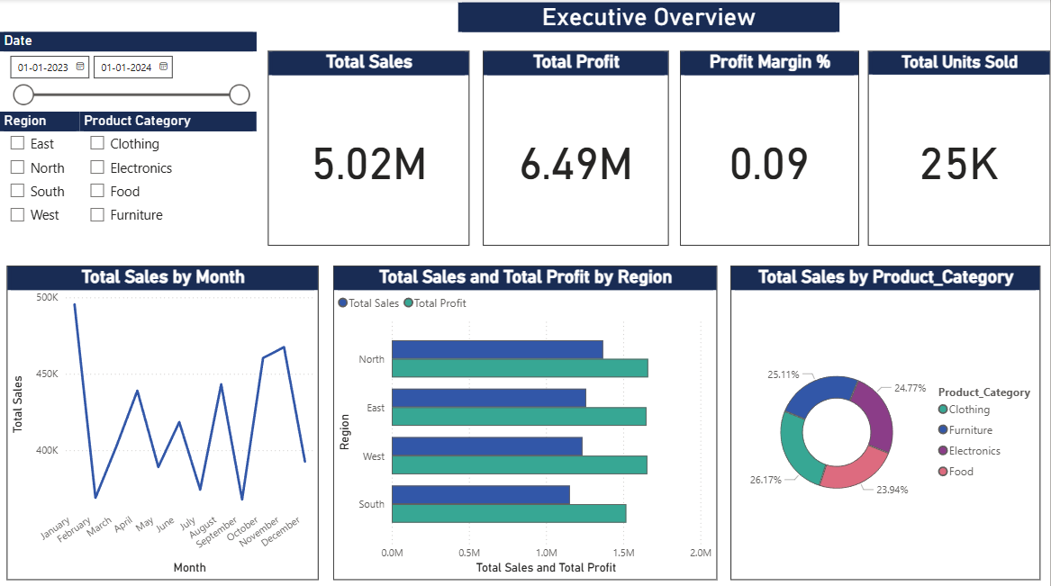
Executive Overview

Slide 3
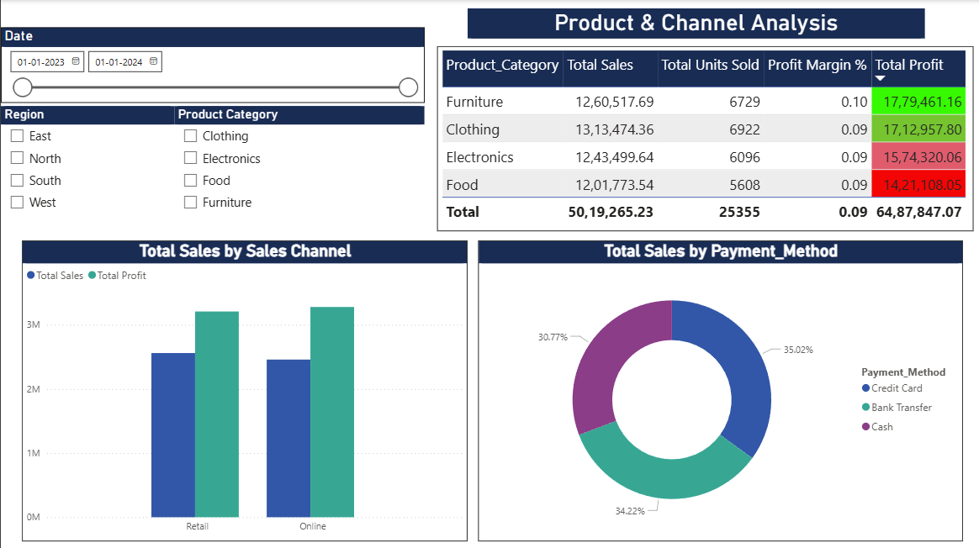
Product & Channel Analysis
Top 3 product categories contributing to 70%+ of revenue.
Online channel leads with 34.22% share.
Credit Card is the most used payment method.

Slide 4
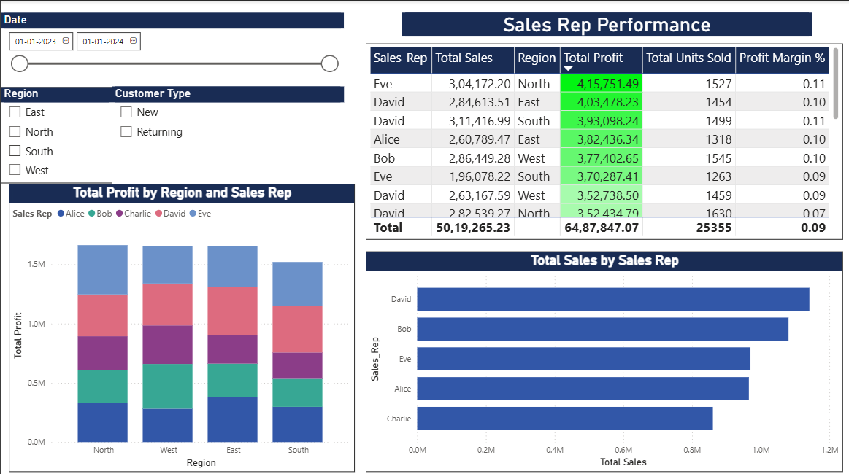
Sales Rep Performance
Top 2 sales reps contribute to over 40% of total revenue.
Region North has the highest performing team.
Rep Charlie needs attention due to declining profit margin.

Slide 5
Dashboard Capabilities for Stakeholders
"What can stakeholders explore?“
Filter performance by Date, Region, Product, Channel.
Compare sales reps, products, and regions.
Drill into product or sales rep level detail.
Identify trends and patterns in sales over time.
View impact of discounts, channels, and payment methods.

Slide 6
Key Recommendations
"What can stakeholders Do Next?“
Optimize inventory for high-selling product categories.
Focus marketing efforts on top-performing regions.
Improve profit margins in underperforming regions (e.g., Region X).
Train or support underperforming sales reps.
Re-evaluate low-performing sales channels.
Expand availability of preferred payment methods.

